Slide 1
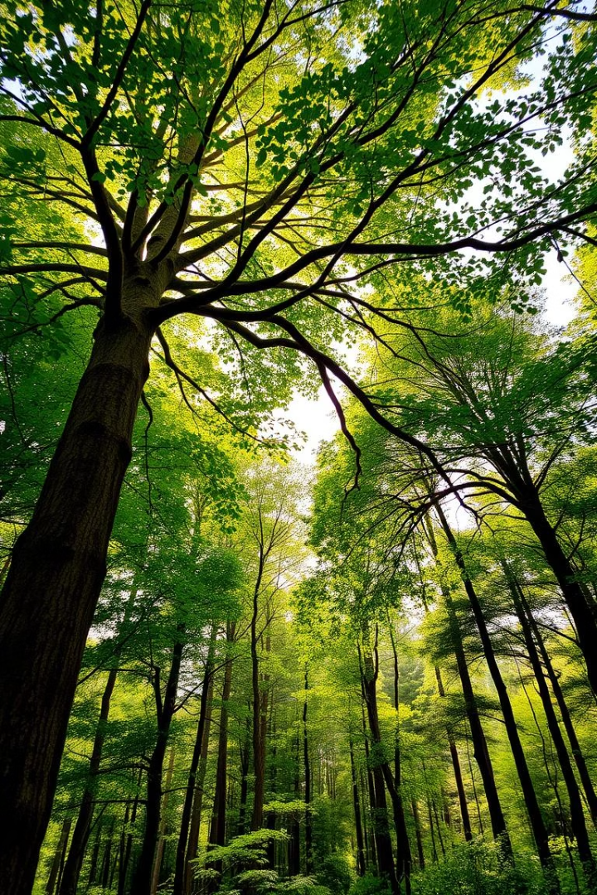
Sandalwood Tree Tracker: An IoT-based Monitoring & Alert System
Presented by: Mehak Sharma, 21114060 Anupriya Dey, 21114014 Manashree Kalode, 21114057
Course: Internet of Things | Group No. 12

Slide 2

Project Overview
Objective
Problem Statement
To safeguard sandalwood trees using sensor data and predictive analytics.
Illegal logging and environmental threats require real-time monitoring and alert systems.

Slide 3
Hardware and System Architecture
Components Used
ESP8266 Microcontroller Unit
MPU6050 Accelerometer Sensor and Gyroscope
Neo6M GPS Module
BMP280 Temperature and Pressure Sensor
Power Supply

Slide 4
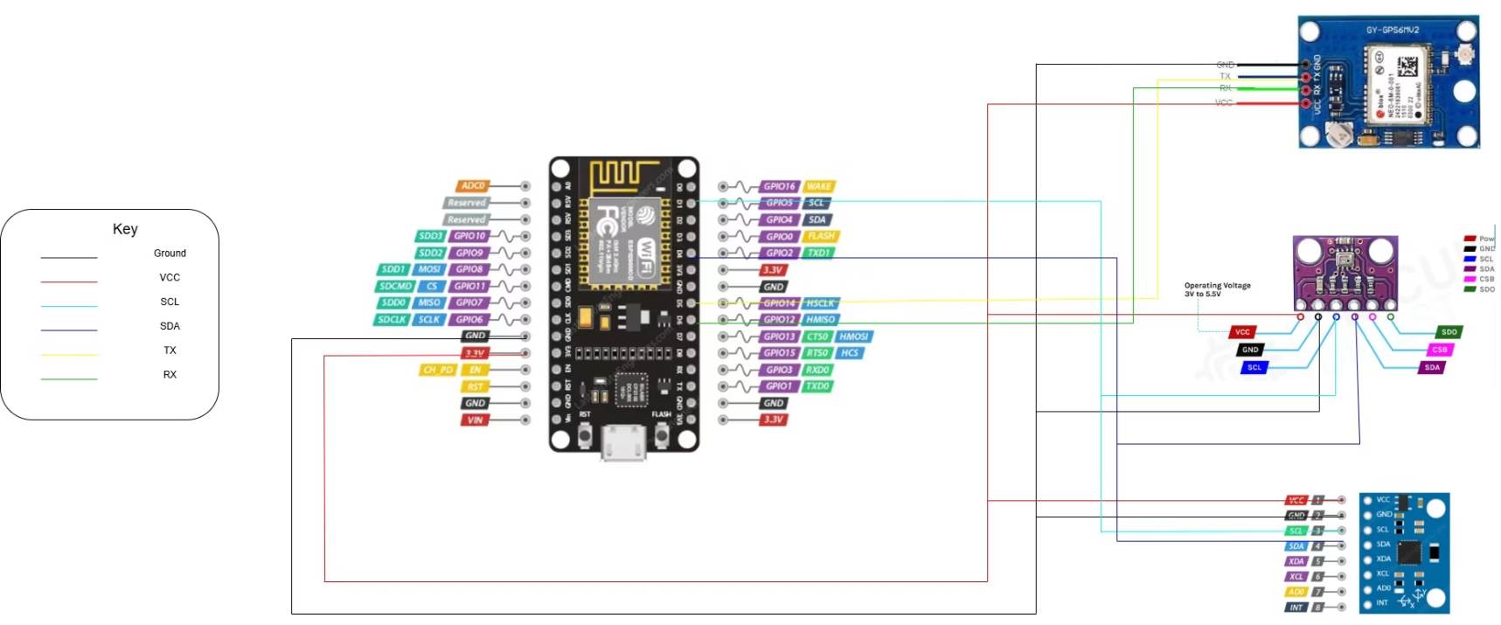
Schematic Diagram

Slide 5

Software and Data
🤖Firmware / Embedded Code
Backend
Programmed using Arduino IDE.
🌐 Built with Node.js + Express: Handles HTTP requests, serves frontend (/public), and manages API routes.
📚Libraries:
📡 Real-time Sensor Data Streaming: Uses Socket.IO to emit live updates of values.
ESP8266WiFi, HTTPClient, Wire, Adafruit_BMP280, Adafruit_MPU6050, Adafruit_Sensor, TinyGPS++, Time, ESP8266Firebase, NTPClient, WifiUdp
📁 Firebase Realtime Database Integration
📧 Email Alert System with Nodemailer: Sends email alerts when temperature exceeds a threshold, Dynamically loads subscribed emails from Firebase.

Slide 6

Results and Demonstration
Serial Monitor Output
Database
Live Dashboard
GPS Coordinates, Acceleration & Gyroscope, Temperature and Pressure.
Firebase Realtime Database NoSQL( JSON format) Stored as
Current Values
Time Series Prediction Graphs for Temp and Pressure
{Key:Sensor/Timestamp, Value:SensorValue}
Movement and Location tracking
Live Alerts for Forest Fire, Storm, Falling, Movement and Position.

Slide 7
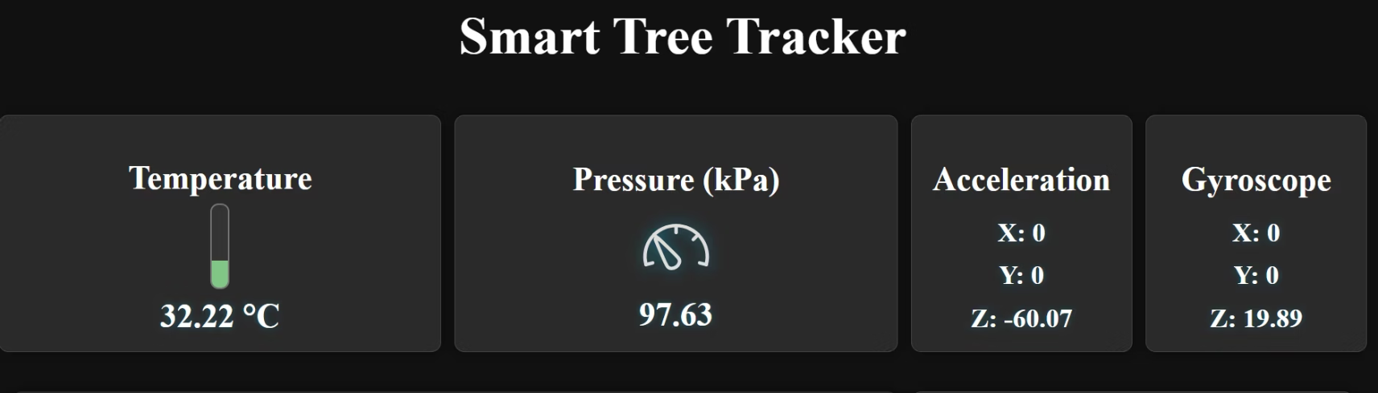
Dashboard UI
The Dashboard provides easy access to all vital surrounding parameters at a glance

Slide 8
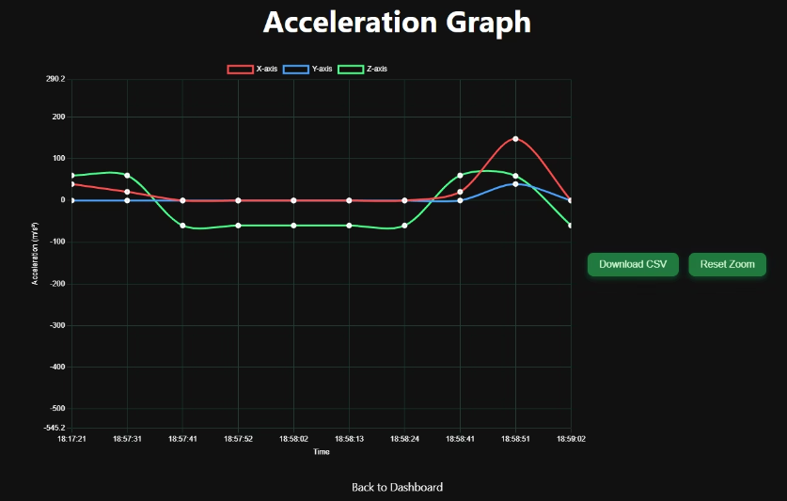
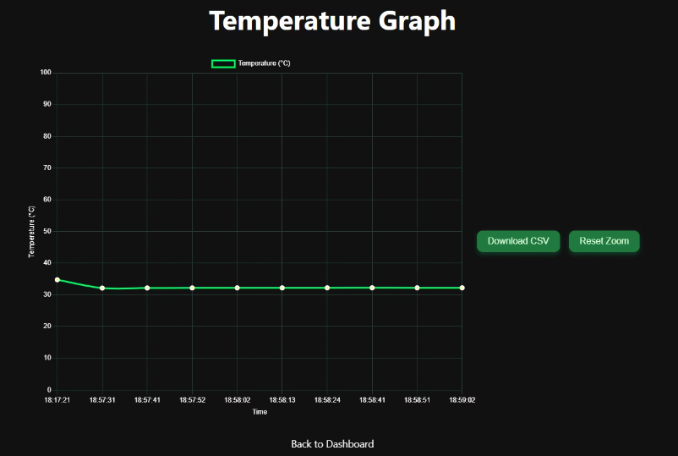
Plots for various Sensors

Slide 9
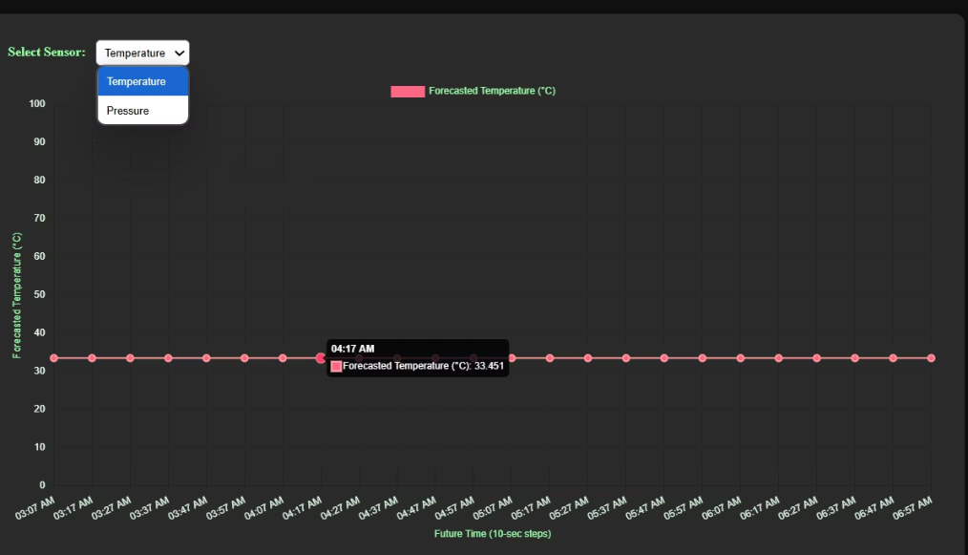
Key Features
1. Prediction Using Time Series Transformer
We leverage historical temperature and pressure data to forecast future weather conditions using a state-of-the-art Time Series Transformer (PatchTST). These insights guide irrigation strategies—a drop in pressure may signal incoming rainfall, allowing us to conserve water, while rising temperatures indicate increased water demand, prompting more intensive irrigation.
A stable, steady prediction trend indicates normal temperature and pressure conditions

Slide 10

2. Alerts for Various Events
Our system actively monitors key environmental and positional parameters to flag potential threats or anomalies. When such conditions are detected, real-time alerts are generated.
📍 Position Change
🔥 Forest Fire Detection
Any unexpected change in geolocation triggers a positional anomaly alert, indicating possible displacement.
A recorded temperature exceeding 60°C may indicate a potential forest fire.
⚠️ Storm Warning
🚗 Unusual Movement
An atmospheric pressure drop below 90 kPa can signal the onset of severe storm conditions.
If GPS data shows speed above a defined threshold, it may suggest that the tree is being moved or tampered with.
🌳 Fallen or Cut Down Tree
An abrupt drop in the GPS-reported altitude below a set threshold triggers an alert for a fallen or cut-down tree

Slide 11
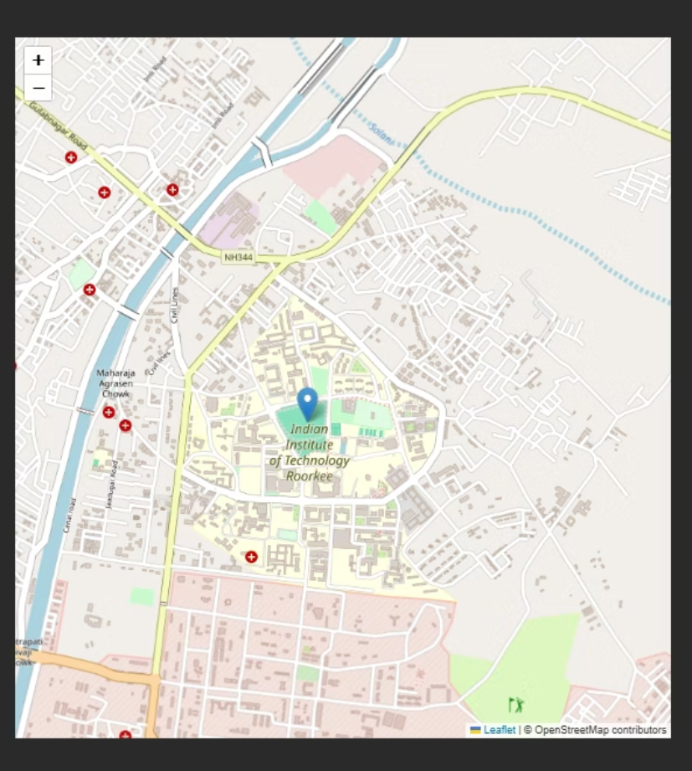
3. Map Location Visualization
On the index page, we provide a visual representation of the tree's location using an interactive map image.
This allows users to quickly identify the exact geographical position of the monitored site. Real-time updates ensure that any positional changes—such as displacement or movement—are immediately reflected on the map, aiding in rapid response and situational awareness.

Slide 12

4.Alert Subscriber List
To ensure important alerts are not missed, we maintain a subscriber list in our database. Users can opt in through the 'Subscribe to Alerts' option available in the UI. Once subscribed, they receive real-time email notifications for critical events.
This ensures timely awareness of potential threats such as forest fires, storm warnings, or tree tampering, enhancing both responsiveness and safety.
Users can subscribe to our mailing list to receive alerts for unusual activity

Slide 13
Thank You :)

